Slide 1
Support Vector Clustering
Asa Ben-Hur, David Horn, Hava T. Siegelmann, Vladimir Vapnik
Zhuo Liu

Slide 2
Clustering
Grouping a set of objects which are similar
Similarity: distance, density, statistical distribution
Unsupervised learning

Slide 3
Limitation of K-means: Differing Density
Original Data
K-means (3 Clusters)

Slide 4
Limitation of K-means: Non-globular Shapes
Original Data
K-means (2 Clusters)

Slide 5
Support Vector Clustering
Data points are mapped by Gaussian kernel (NOT polynomial kernel or linear kernel) to a Hilbert space
Find minimal enclosing sphere in Hilbert space
Map back the sphere back to data space, cluster forms
Procedure to find this sphere is called the support vector domain description (SVDD)
SVDD is mainly used for outlier detection or novelty detection
SVC is a unsupervised learning method

Slide 6

Support Vector Domain Description (SVDD)
$\{x_{i}\}∈X$ is a data set of N points
Φ is a nonlinear transformation from $X$ to a Hilbert space
Task:
minimize $R$, with constraint
$${\left\|\text{Φ}(x_{j})−a\right\|}^{2}≤R^{2}+{ξ }_{j}$$
$${ξ }_{j}≥0$$

Slide 7

Support Vector Domain Description (SVDD)
Lagrangian:
$${L=R^{2}+C\sum{{ξ }_{j}}−\sum_{j}{(R^{2}+}{ξ }_{j}−\left\|\text{Φ}(x_{j})−a\right\|}^{2})β_{j}−\sum{{ξ }_{j}μ_{j}}$$
where $β_{j}≥0$, $μ_{j}≥0$ are Lagrange multipliers, $C$ is a constant, $C\sum{{ξ }_{j}}$ is the penalty term.

Slide 8

Support Vector Domain Description (SVDD)
Take partial derivatives and set them to be zeroes:
$$\sum_{j}{β_{j}}=1$$
$$a=\sum_{j}{β_{j}\text{Φ}(x_{j})}$$
$$β_{j}=C−μ_{j}$$
And KKT complementarity conditions of Fletcher (1987) result in:
$${ξ }_{j}μ_{j}=0$$
$${(R^{2}+{ξ }_{j}−\left\|\text{Φ}(x_{j})−a\right\|}^{2})β_{j}=0$$

Slide 9

Support Vector Domain Description (SVDD)
If ${ξ }_{j}>0$, then $μ_{j}=0$, then $β_{j}=C$, then ${\left\|\text{Φ}(x_{j})−a\right\|}^{2}=R^{2}+{ξ }_{j}$, so point $x_{j}$ lies outside the sphere, it is called a bounded support vector or BSV.
If ${ξ }_{j}=0$ and $β_{j}=0$, then ${\left\|\text{Φ}(x_{j})−a\right\|}^{2}<R^{2}$, it is inside the sphere.
If ${ξ }_{j}=0$ and ${0<β}_{j}<C$, then ${\left\|\text{Φ}(x_{j})−a\right\|}^{2}=R^{2}$, it lies on the surface of the sphere. Such a point will be referred to as a support vector or SV.
Note that when $C≥1$ no BSVs exist.

Slide 10
Support Vector
Bounded Support Vector
Inner Point

Slide 11

Support Vector Domain Description (SVDD)
Wolfe dual form:
$$W=\sum_{j}{{\text{Φ}(x_{j})}^{2}β_{j}}−\sum_{i,j}{β_{i}β_{j}}\text{Φ}\left(x_{i}\right).\text{Φ}\left(x_{j}\right)$$
with constraints: ${0≤β}_{j}≤C, j=1,…,N.$
Now, we can introduce kernel function such that
$$K\left(x_{i},x_{j}\right)=\text{Φ}\left(x_{i}\right).\text{Φ}\left(x_{j}\right)$$
How does different kernel work?

Slide 12
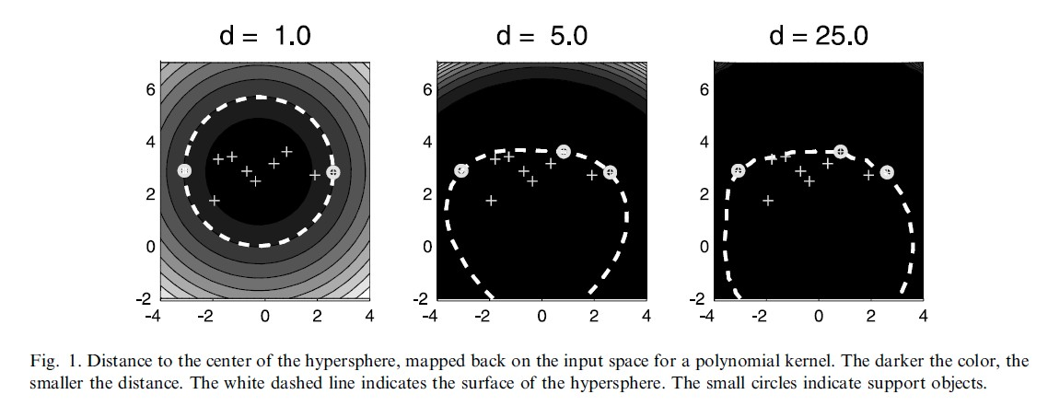

Polynomial Kernel
$$K\left(x_{i},x_{j}\right)={(x_{i}.x_{j}+1)}^{d}$$

Slide 13
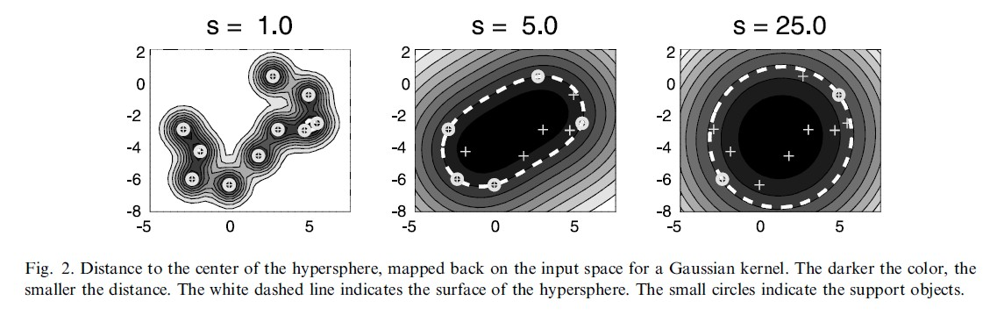

Gaussian Kernel
$$K\left(x_{i},x_{j}\right)=exp{(−(x_{i}−x_{j})}^{2}/s^{2})$$

Slide 14

Cluster Assignment
Generating adjacency matrix $A$
$A$ has component $A(i,j)$ with value either 0 or 1
0: line segment between $x_{i}$ and $x_{j}$ cross out the sphere
1: line segment between $x_{i}$ and $x_{j}$ is always in the sphere
Clustering based on graph-based model

Slide 15



$$A=\left[\begin{matrix}1 & 1 & 1 & 0 & 0 & 0 \\ 1 & 1 & 1 & 0 & 0 & 0 \\ 1 & 1 & 1 & 0 & 0 & 0 \\ 0 & 0 & 0 & 1 & 1 & 1 \\ 0 & 0 & 0 & 1 & 1 & 1 \\ 0 & 0 & 0 & 1 & 1 & 1\end{matrix}\right]$$
$$Laplacian=\left[\begin{matrix}2 & −1 & −1 & 0 & 0 & 0 \\ −1 & 2 & −1 & 0 & 0 & 0 \\ −1 & −1 & 2 & 0 & 0 & 0 \\ 0 & 0 & 0 & 2 & −1 & −1 \\ 0 & 0 & 0 & −1 & 2 & −1 \\ 0 & 0 & 0 & −1 & −1 & 2\end{matrix}\right]$$
Second Smallest Eigenvalue for Laplacian:
$$λ_{2}=0$$
So there are two clusters.

Slide 16
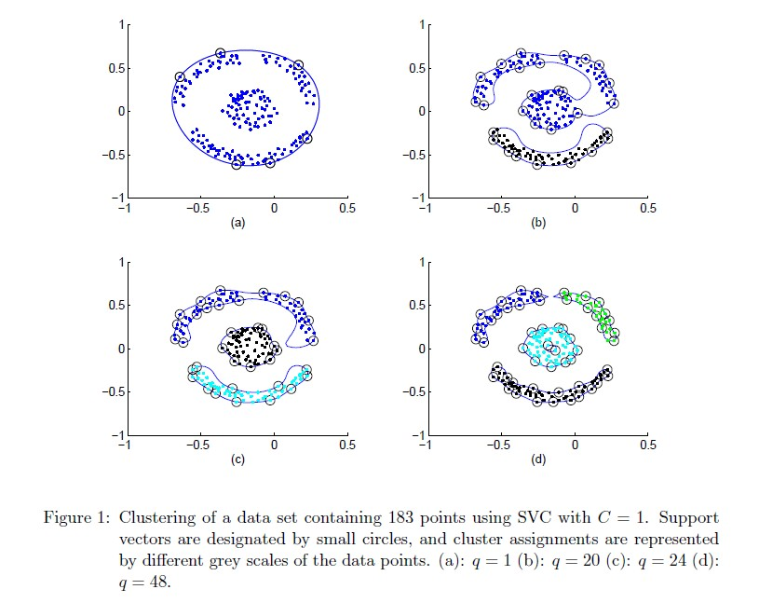

Example
$$K\left(x_{i},x_{j}\right)=\exp{(−q{\left\|x_{i}−x_{j}\right\|}^{2})}$$

Slide 17

Example with BSVs
In real data, clusters are usually not as well separated as in previous example, so we need to allow some BSVs.
BSVs are assigned to the cluster that they are closest to.
An important parameter - upper bound on the fraction of BSVs:
$$p=\frac{1}{NC}$$
where $N$ is number of points, $C$ is the coefficient for penalty term.
Asymptotically (for large $N$), the fraction of outliers tends to $p$.

Slide 18
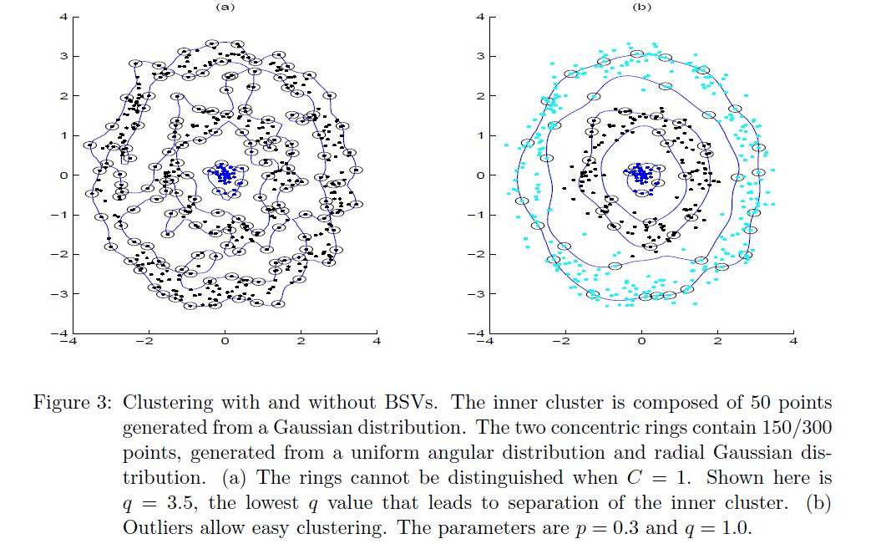
Example with BSVs

Slide 19
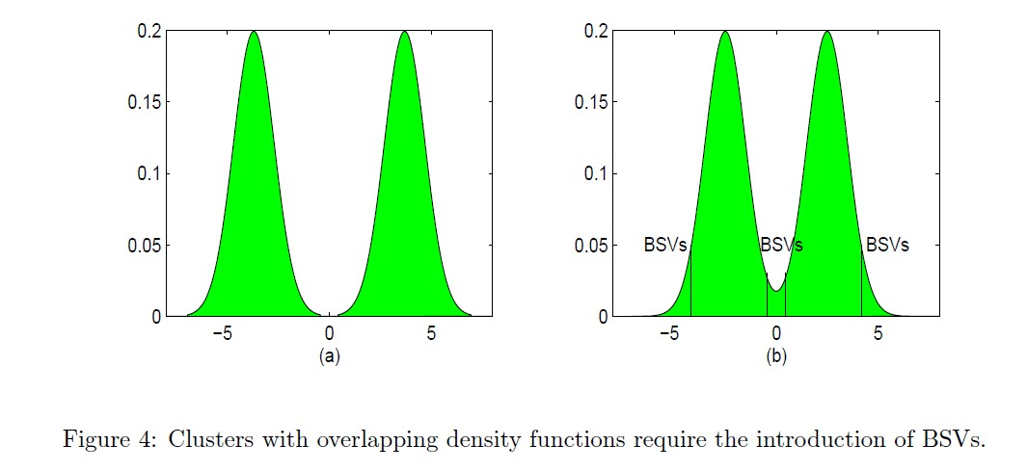
Clusters with Overlapping Density Functions

Slide 20
Experiment on Iris Data
There are three types of flowers, represented by 50 instances each
First two principal components space:
1. q = 6 p = 0.6
2. the third cluster split into two
3. When these two clusters are considered together, the result is 2 misclassifications
First three principal component space:
1. q = 7.0 p = 0.70
2. four misclassifications
First four principal component space:
1. q = 9.0 p = 0.75
2. 14 misclassifications
# of SVs: 18 in 2D, 23 in 3D, 34 in 4D
Reason for improvement in 2d and 3d: PCA reduces noise

Slide 21
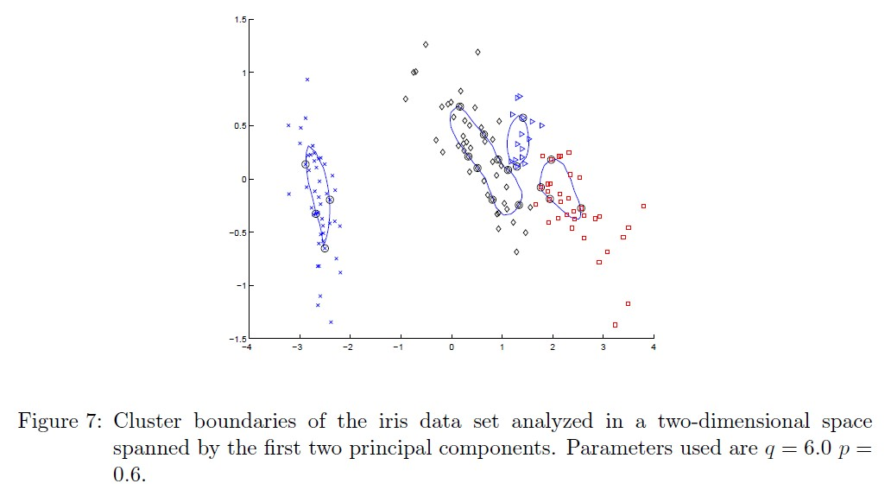
Experiment on Iris Data

Slide 22
Compare with Other Non-Parametric Clustering Algorithms
The information theoretic approach of Tishby and Slonim (2001) : 5 misclassifications.
The SPC algorithm of Blatt et al. (1997), when applied to the dataset in the original data-space: 15 misclassifications.
SVC: 2 misclassification in first two PCs space, 4 misclassification in first three PCs space.

Slide 23

Principle to Choose Parameter
Starting from a small value of q and increasing it. Initial value can be chosen as:
$$q=\frac{1}{\max_{i,j}{{\left\|x_{i}−x_{j}\right\|}^{2}}}$$
which will result in a single cluster, so no outliers are needed, hence choose $C=1$.
Criteria : a low number of SVs guarantees smooth boundaries.
If the number of SVs is excessive, or a number of singleton clusters form, one should increase $p$ to allow SVs to turn into BSVs, and smooth cluster boundaries emerge.
In other words, we need to systematically increase q and p along a direction that guarantees a minimal number of SVs.

Slide 24

Complexity
SMO algorithm of Platt (1999) to solve the quadratic programming problem – very efficient
Labeling part: $O({\left(N−n_{bsv}\right)}^{2}n_{sv}d)$
If # of SVs is O(1), labeling part: $O(N^{2}d)$
Memory usage: O(1).
In overall, SVC is useful even for very large datasets

Slide 25
Conclusion
SVC has no explicit bias of either the number, or the shape of clusters
SVC is a unsupervised clustering algorithm
Two parameters:
q: when it increases, clusters begin to split
p: soft margin constant that controls the number of outliers
A unique advantage: cluster boundaries can be of arbitrary shape, whereas other algorithms are most often limited to hyper-ellipsoids

Slide 26
References
A. Ben-Hur, A. Elisseeff, and I. Guyon. A stability based method for discovering structure in clustered data. in Pacific Symposium on Biocomputing, 2002.
A. Ben-Hur, D. Horn, H.T. Siegelmann, and V. Vapnik. A support vector clustering method. in International Conference on Pattern Recognition, 2000.
A. Ben-Hur, D. Horn, H.T. Siegelmann, and V. Vapnik. A support vector clustering method. in Advances in Neural Information Processing Systems 13: Proceedings of the 2000 Conference, Todd K. Leen, Thomas G. Dietterich and Volker Tresp eds., 2001.
C.L. Blake and C.J. Merz. Uci repository of machine learning databases, 1998.
Marcelo Blatt, Shai Wiseman, and Eytan Domany. Data clustering using a model granular magnet. Neural Computation, 9(8):1805–1842, 1997.
R.O. Duda, P.E. Hart, and D.G. Stork. Pattern Classification. John Wiley & Sons, New York, 2001. R.A. Fisher. The use of multiple measurments in taxonomic problems. Annals of Eugenics, 7:179–188, 1936.
R. Fletcher. Practical Methods of Optimization. Wiley-Interscience, Chichester, 1987.
K. Fukunaga. Introduction to Statistical Pattern Recognition. Academic Press, San Diego, CA, 1990.
A.K. Jain and R.C. Dubes. Algorithms for clustering data. Prentice Hall, Englewood Cliffs, NJ, 1988.
H. Lipson and H.T. Siegelmann. Clustering irregular shapes using high-order neurons. Neural Computation, 12:2331–2353, 2000.

Slide 27
References
J. MacQueen. Some methods for classification and analysis of multivariate observations. In Proc. 5th Berkeley Symposium on Mathematical Statistics and Probability, Vol. 1, 1965.
G.W. Milligan and M.C. Cooper. An examination of procedures for determining the number of clusters in a data set. Psychometrika, 50:159–179, 1985.
J. Platt. Fast training of support vector machines using sequential minimal optimization. In Advances in Kernel Methods — Support Vector Learning, B. Sch¨olkopf, C. J. C. Burges, and A. J. Smola, editors, 1999.
B.D. Ripley. Pattern recognition and neural networks. Cambridge University Press, Cambridge, 1996.
S.J. Roberts. Non-parametric unsupervised cluster analysis. Pattern Recognition, 30(2): 261–272, 1997.
B. Sch¨olkopf, R.C. Williamson, A.J. Smola, J. Shawe-Taylor, and J. Platt. Support vector method for novelty detection. in Advances in Neural Information Processing Systems 12: Proceedings of the 1999 Conference, Sara A. Solla, Todd K. Leen and Klaus-Robert Muller eds., 2000.
Bernhard Sch¨olkopf, John C. Platt, John Shawe-Taylor, , Alex J. Smola, and Robert C. Williamson. Estimating the support of a high-dimensional distribution. Neural Computation, 13:1443–1471, 2001.
R. Shamir and R. Sharan. Algorithmic approaches to clustering gene expression data. In T. Jiang, T. Smith, Y. Xu, and M.Q. Zhang, editors, Current Topics in Computational Biology, 2000.
D.M.J. Tax and R.P.W. Duin. Support vector domain description. Pattern Recognition Letters, 20:1991–1999, 1999.
N. Tishby and N. Slonim. Data clustering by Markovian relaxation and the information bottleneck method. in Advances in Neural Information Processing Systems 13: Proceedings of the 2000 Conference, Todd K. Leen, Thomas G. Dietterich and Volker Tresp eds., 2001.
V. Vapnik. The Nature of Statistical Learning Theory. Springer, New York, 1995.

Slide 28
Thanks!

