Slide 1
Transformer for Modeling Physical Systems
Michael Holland
Advisor: Ming Zhong
Department of Mathematics

Slide 2
Transformer Architecture Background
Applications to PINNs

Slide 3
NLP has used RNN architectures, but has large computational costs and difficulty with long-range dependencies
NLP primarily used RNN and LSTM architectures to create bots that can imitate language prior to 2017
RNN and LSTM had well known limitations due to how the architectures were set up:
Training was computationally expensive since RNNs require sequential training on data, meaning you can’t parallelize the compute
RNNs, and subsequent attempts at LSTM models, had difficulty in remembering what was produced earlier in the prediction sequence
RNN Training Sequence
$$Input sequence:x_{1}→x_{2}→x_{3}$$
$$h_{t}=f\left(h_{t−1},x_{t}\right)$$
$$x_{1}is processed →output h_{1}→h_{1}+x_{2} is processed →output h_{2}→h_{2}+x_{3} is processed →output h_{3}→…$$

Slide 4
Transformer architecture solves the computational problem by utilizing self-attention mechanisms
A team of Google researchers in 2017 published the paper “Attention is all you need” that introduced the transformer architecture
By utilizing the new self-attention mechanism, you can find the relation between all possible answers to determine the next best step
Self-attention matrix A
Definition:
Let $x_{i}∈ℝ^{d_{k}}$, where $d_{k}$ represents the size of your vocabulary and $x_{i}$ is a token. Let $A^{d_{k}×d_{k}}$ be the matrix with entries $w_{ij}$ representing the weights of self-attending tokens. Matrix A is the self-attention matrix
 | $$x_{1}$$ | $$x_{2}$$ | $$…$$ | $$x_{V}$$
$$x_{1}$$ | $$w_{11}$$ | $$w_{12}$$ | $$…$$ | $$w_{1V}$$
$$x_{2}$$ | $$w_{21}$$ | $$w_{22}$$ | $$…$$ | $$w_{2V}$$
$$⋮$$ | $$⋮$$ | $$⋮$$ | $$⋱$$ | $$⋮$$
$$x_{V}$$ | $$w_{V1}$$ | $$w_{V2}$$ | $$…$$ | $$w_{VV}$$
$$Q=x_{i} ∙W_{Q}$$
$$K=x_{i}∙W_{k}$$
$$V=x_{i}∙W_{V}$$
$$Z=softmax\left(\frac{Q∙K^{T}}{\sqrt{d_{k}}}\right)$$
$$w_{ij}=Z∙V$$

Slide 5
Sketch of a general transformer architecture
Encoder
Decoder
Layer normalization
Layer normalization
Inputs
Input Embedding
Multi-Head Attention
Feed Forward Network
Multi-Head Attention
Multi-Head Attention
Multi-Head Attention
Outputs
Multi-Head Attention
Multi-Head Attention
Positional encoding

Slide 6
Transformer Architecture Background
Applications to PINNs

Slide 7
Time series problems have proven to be difficult for PINNs, PITs aim to solve this by utilizing the attention mechanism
Limitations of FNNs and RNNs with long-range predictions mean that for a sufficient time interval, the model will lose memory of previous prediction steps
PITs aim to solve this by utilizing the self-attention mechanism to keep track of the time series dependency as the model trains
A sample of problems that are difficult for PINNs:
Advection-dominated problems
Shock problems
Navier-Stokes with high Reynolds number
Allen-Cahn with small diffusion
Hamilton-Jacobi equations
Notes:
Some of these are due to loss optimizers AND time series issues

Slide 8
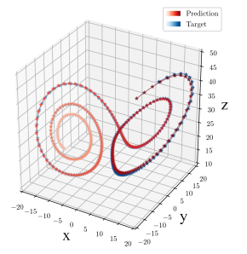
A group at Notre Dame is utilizing Koopman operators to train the encoder/decoder and establish a time series connection
[1]
Lorenz System:
$$\frac{dx}{dt}=σ\left(y−x\right)$$
$$\frac{dy}{dt}=x\left(ρ−z\right)−y$$
$$\frac{dz}{dt}=xy−βz$$
[1]
[1] Transformers for Modeling Physical Systems, Genva and Zabaras 2021

Slide 9
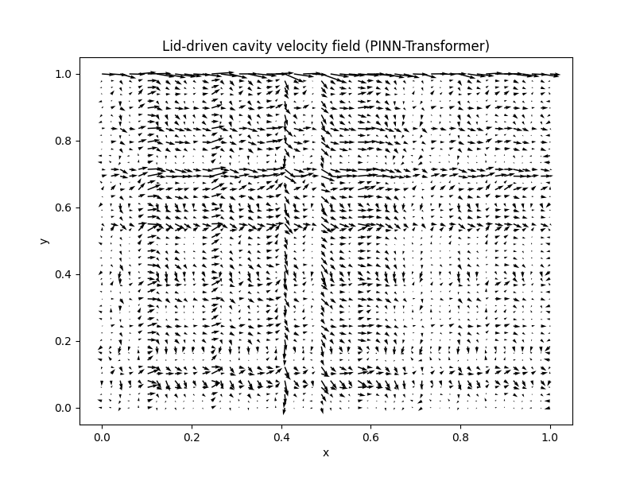
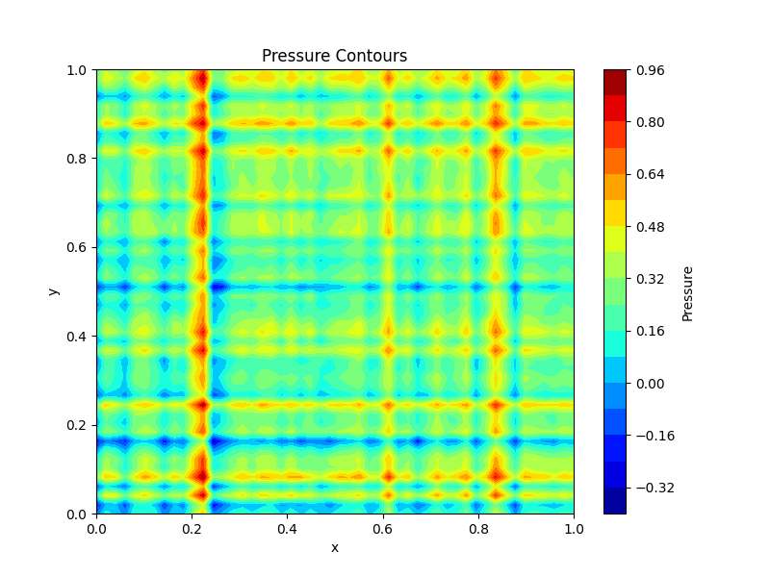
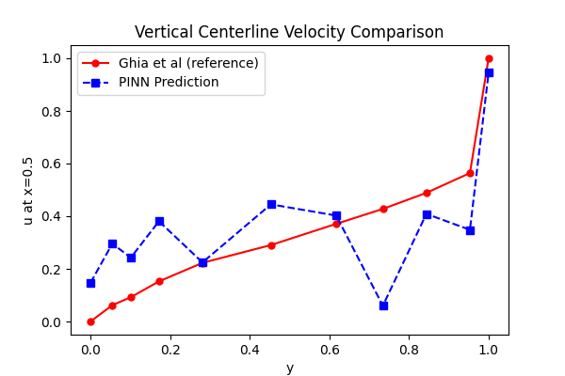
Current work from us is focused on utilizing the PDE to enforce time series connections in training
A few items we are actively looking into:
Utilizing PDEs in unsupervised learning
Understanding attention mechanism connections to time series data
Expanding architecture to problems in higher dimensions
Loss function analysis
Initial runs with the 2D Navier-Stokes equation with incompressible fluid
Notes:
Some of these are due to loss optimizers AND time series issues

